Slide 1
K MEANS CLUSTERING

Slide 2
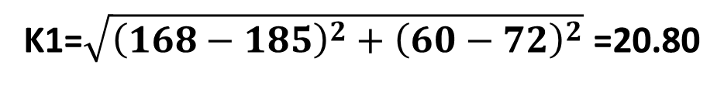

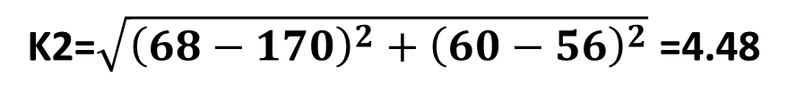
K MEANS CLUSTERING
K1
 | Height | Weight
1 | 185 | 72
2 | 170 | 56
3 | 168 | 60
4 | 179 | 68
5 | 182 | 72
6 | 188 | 77
7 | 180 | 71
8 | 180 | 70
9 | 183 | 84
10 | 180 | 88
11 | 180 | 67
12 | 177 | 76
K2
(185, 72)
(170, 56)
Euclidean Distance
$$\sqrt{{\left(X_{o}−X_{c}\right)}^{2}+{\left(Y_{o}−Y_{c}\right)}^{2}}$$
Euclidean Distance for 3:
K1=$\sqrt{{\left(168−185\right)}^{2}+{\left(60−72\right)}^{2}}$ =20.80
K2=$\sqrt{{\left(68−170\right)}^{2}+{\left(60−56\right)}^{2}}$ =4.48

Slide 3
New Centroid Calculation:
For K2=((170+168)/2, (60+56)/2) =(169,58)
K1
K2
(185, 72)
(169, 58)

Slide 4
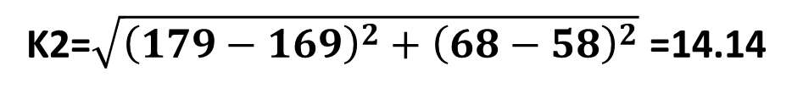
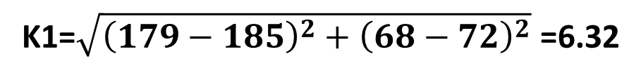
Euclidean Distance for 4:
K1=$\sqrt{{\left(179−185\right)}^{2}+{\left(68−72\right)}^{2}}$ =6.32
K2=$\sqrt{{\left(179−169\right)}^{2}+{\left(68−58\right)}^{2}}$ =14.14
K1 -> {1,4,5,6,7,8,9,10,11,12}
K2 -> {2,3}

